Slide 1


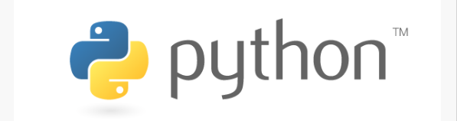
PYTHON Programming
By: Surendrakc

Slide 2
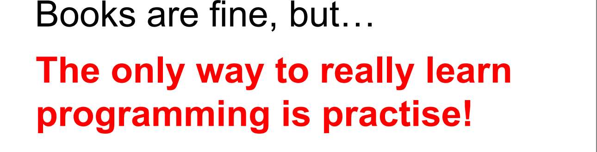


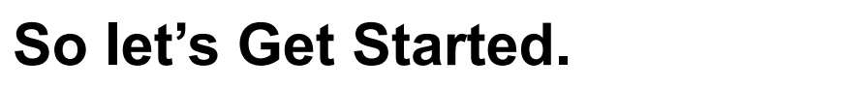

Slide 3
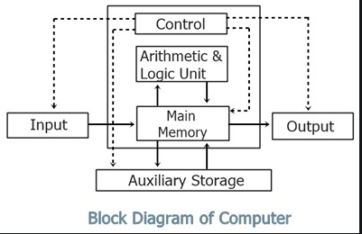

LOYAL IDIOT?

Slide 4
What is computer programming?
WRITING EXECUTABLE COMPUTER PROGRAM FOR ACCOMPLISHING A SPECIFIC COMPUTING TASK.
programming is to find a sequence of instructions that will automate the performance of a task
way of giving computers instructions about what they should do next
These instructions are known as code, and computer programmers write code to solve problems or perform a task.
he main purpose of programming is to have a machine do a task for us. (Hopefully programming the machine to do this is less effort in the long run)
Programming is writing instructions for a incredibly loyal idiot

Slide 5
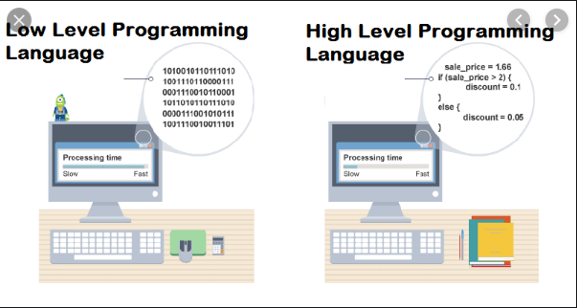
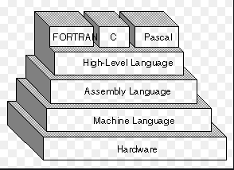
Programming languages

Slide 6
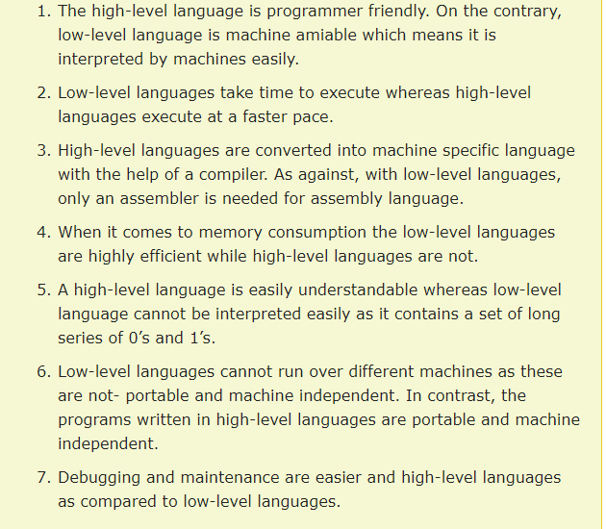
Programming languages

Slide 7
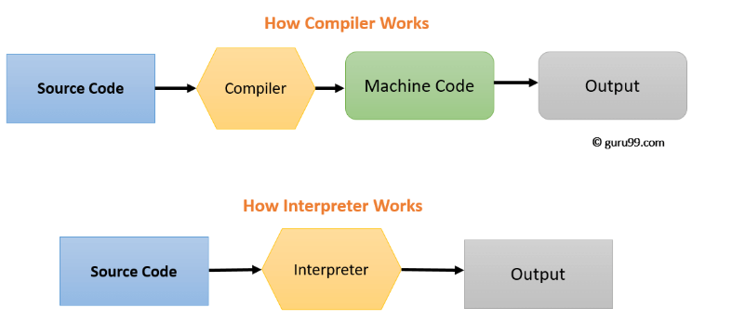
A computer program that transforms source code written in a high-level programming language into a lower level language (COMPILER,interpreter)

Slide 8
Compiler vs Interpreter
COMPILER | INTERPRETER
Compile will parse or analyses all of the language statements for its correctness. If incorrect, throws an error If no error, the compiler will convert source code to machine code. | Source statements executed line by line DURING Execution
Generates intermediate object code which further requires linking, hence requires more memory | No intermediate object code is generated, hence are memory efficient.
It generates the error message only after scanning the whole program. Hence debugging is comparatively hard. | Continues translating the program until the first error is met, in which case it stops. Hence debugging is easy
The compilation is done before execution. | Compilation and execution take place simultaneously.
Display all errors after compilation, all at the same time. Debugging harder | Displays error of each line one by one. Debugging easier
Compile once and run anytime. Faster | Line by line interpreted every time they run. Slow
Programming language like C, C++ use compilers. | Programming language like Python, Ruby use interpreters.

Slide 9
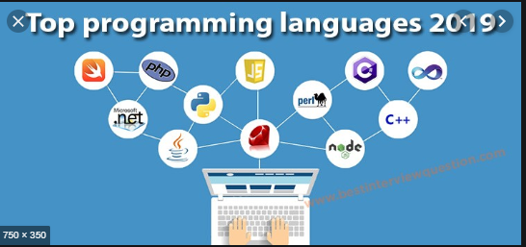
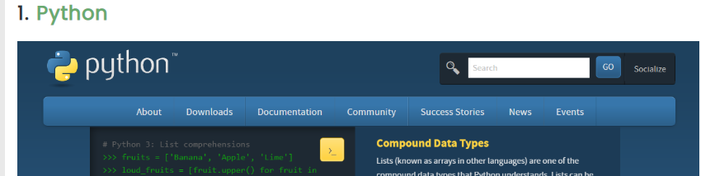
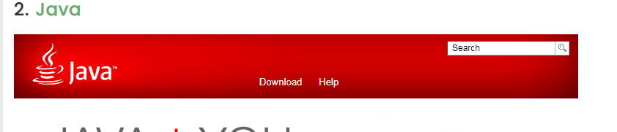
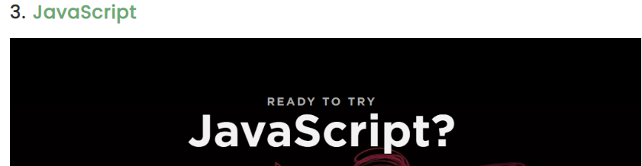
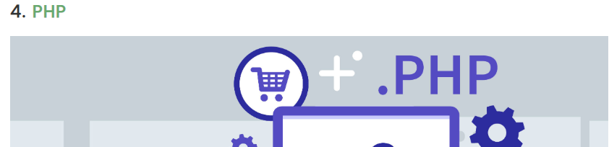
PYTHON Tops the list: GitHub

Slide 10
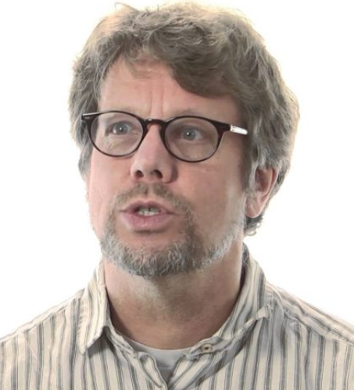

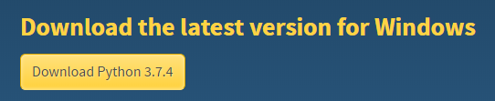
Python
Fun fact. Python is not named after the snake. It’s named after the British TV show Monty Python’s Fly Circus
Python was introduced by Guido Van Rossum in 1989
ABC Programming influenced the design and development of python.

Slide 11
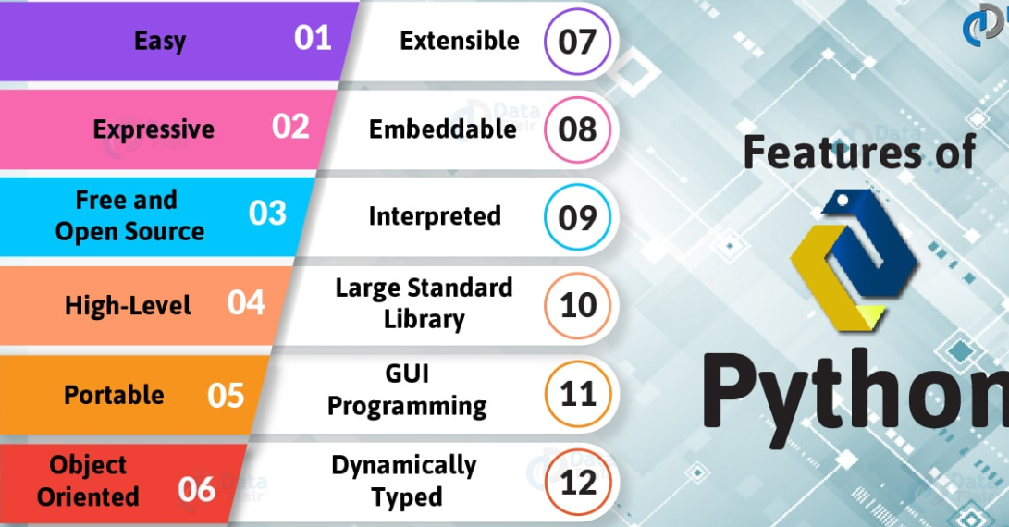
PYTHON FEATURES

Slide 12
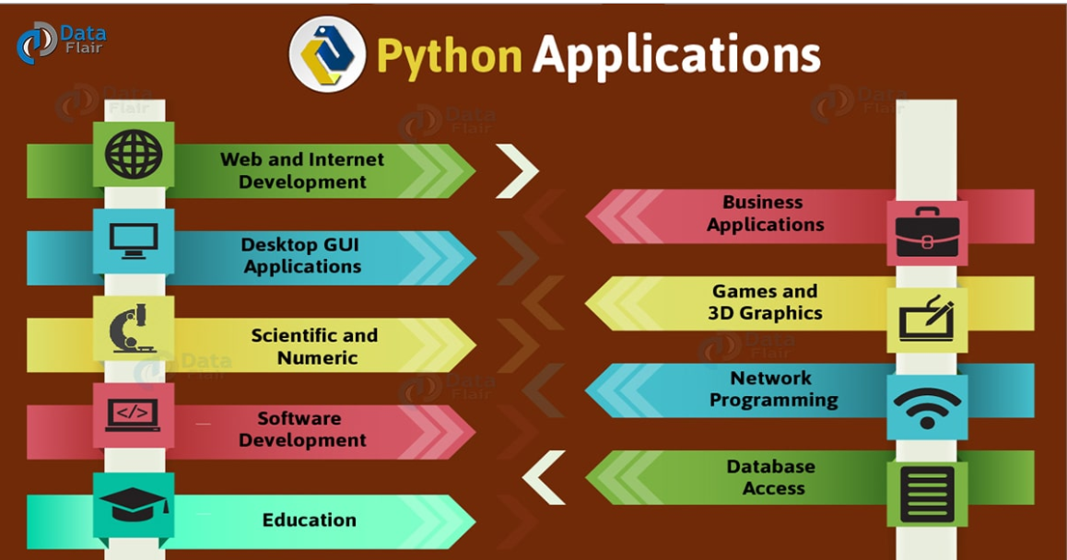

Slide 13
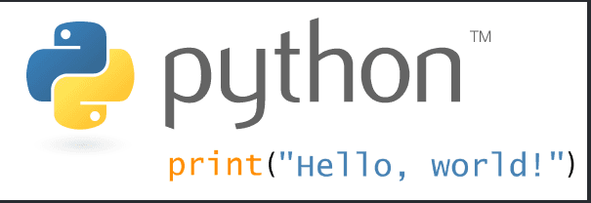

Slide 14
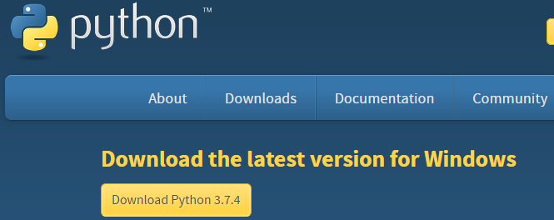
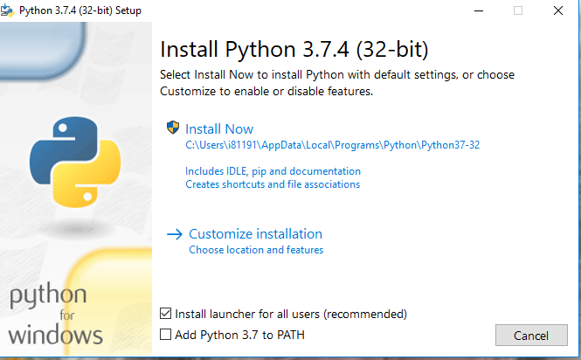
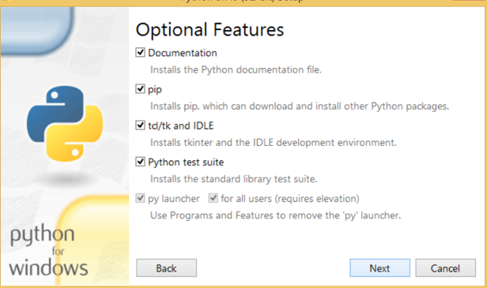
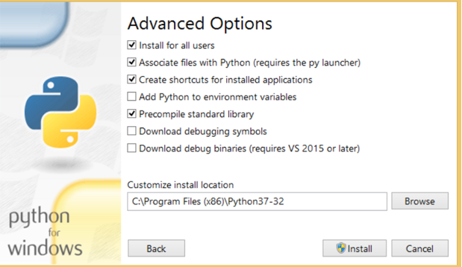
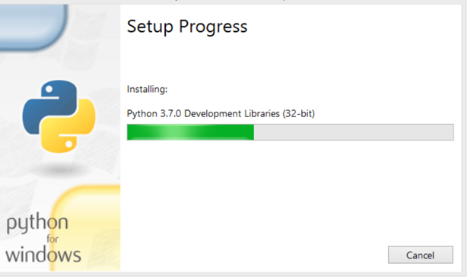
How to Install Python (Environment Set-up)
https://www.python.org/downloads/
Visit the link https://www.python.org/downloads/ to download the latest release of Python

Slide 15
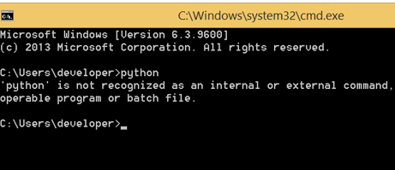
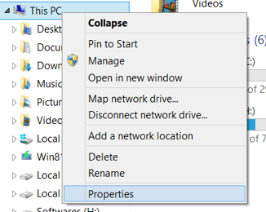
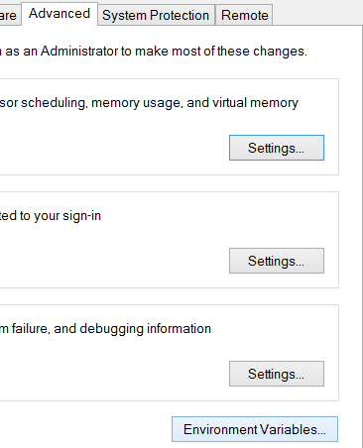
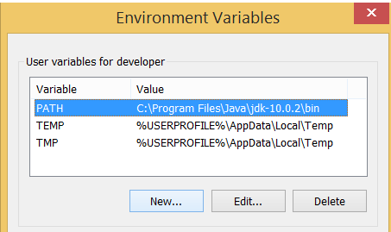
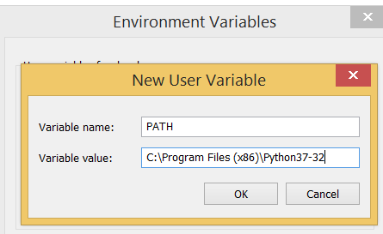
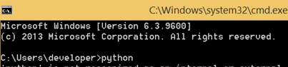

Slide 16
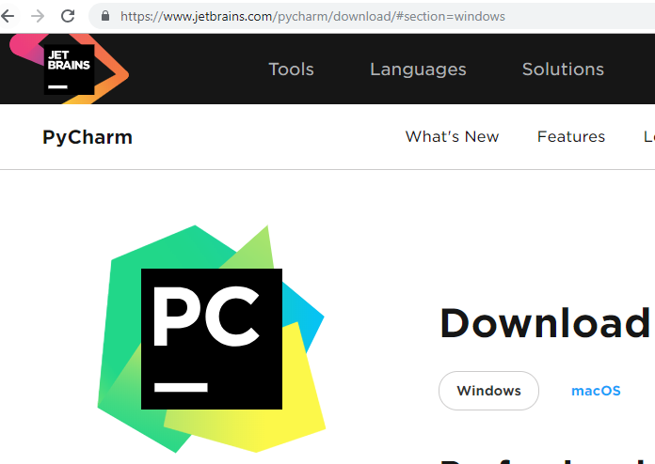
IDE
Save and reload code files
Debugging support
Syntax highlighting
Automatic code formatting
MANY MORE…

Slide 17
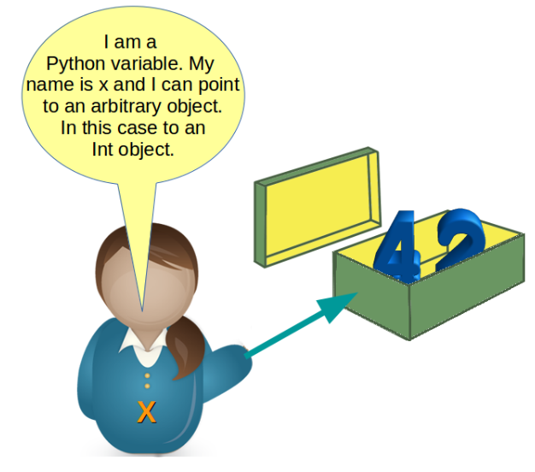
PYTHON VARIABLE
A VARIABLE IS SOMETHING THAT CAN CHANGE.
A variable is a way of referring to a memory location used by a computer program
A VARIABLE IS THE NAME GIVEN TO THE PORTION OF MEMORY LOCATION WHERE DIFFERENT KINDS OF DATA ARE STORED. While the program is running, variables are accessed and sometimes changed, i.e., a new value will be assigned to a variable.

Slide 18
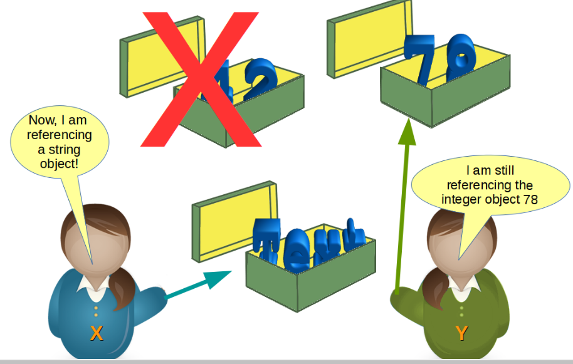
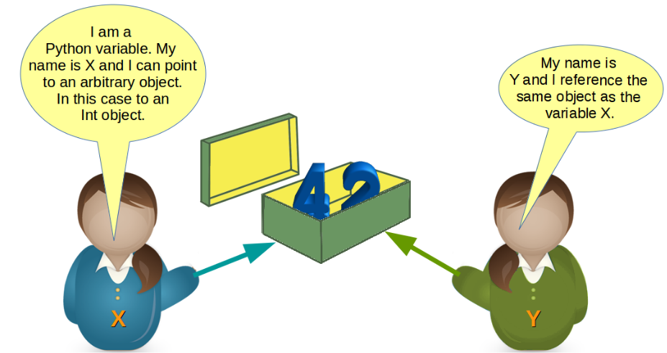
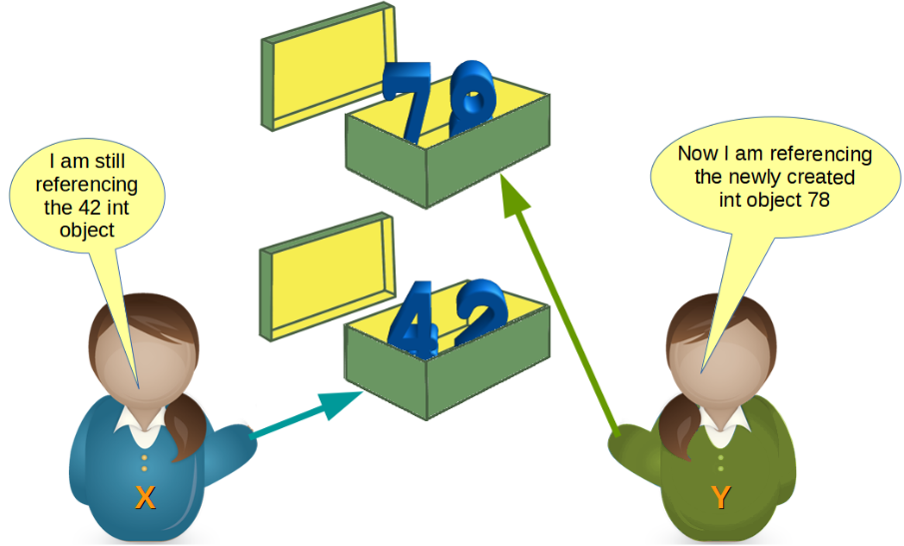

Slide 19
VARIABLE NAMING CONVENTION
The first character of the variable must be an alphabet or underscore ( _ )
All the characters except the first character may be an alphabet of lower-case(a-z), upper-case (A-Z), underscore or digit (0-9)
Identifier name must not contain any white-space, or special character (!, @, #, %, ^, &, *)
Identifier name must not be similar to any keyword defined in the language
Identifier names are case sensitive for example my name, and MyName is not the same
Examples of valid identifiers : a123, _n, n_9, etc
Examples of invalid identifiers: 1a, n%4, n 9, etc. Multiple variable assignments is also possible.
Syntax: variable_name=value

Slide 20
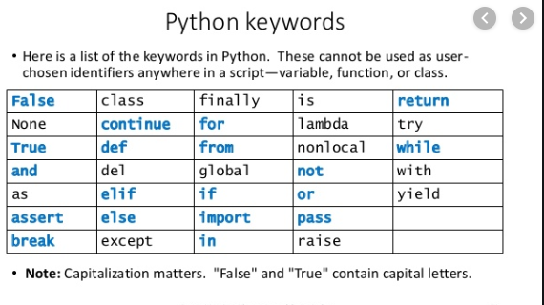
keywords
Keywords are the reserved words in Python
We cannot use a keyword as a variable name, function name or any other identifier
In Python, keywords are case sensitive
There are 33 keywords in Python 3.7
They have pre-defined meanings and these keywords have to be used to develop programming instructions

Slide 21
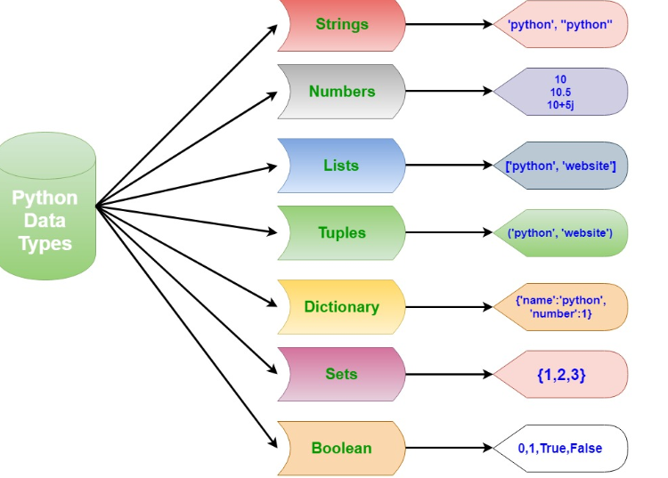
datatypes
Refers to the information stored in a variable
Python data types are dynamic, because we don’t need to mention type of the variable

Slide 22
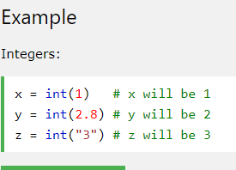
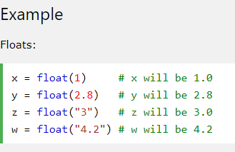
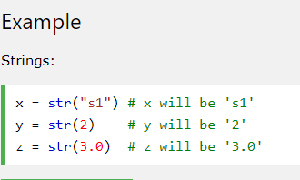
Type conversion (casting)
Conversion of one data type to another type
INT(): CONVERTS AN INTEGER NUMBER FROM AN INTEGER LITERAL, A FLOAT LITERAL (BY ROUNDING TO THE PREVIOUS WHOLE NUMBER), OR A STRING LITERAL (providing the string represents a whole number)
Float(): converts a float number from an integer literal, a float literal or a string literal (providing a string represents a float or an integer)
Str(): converts a string from a wide variety of data types including strings, integer and float literals

Slide 23
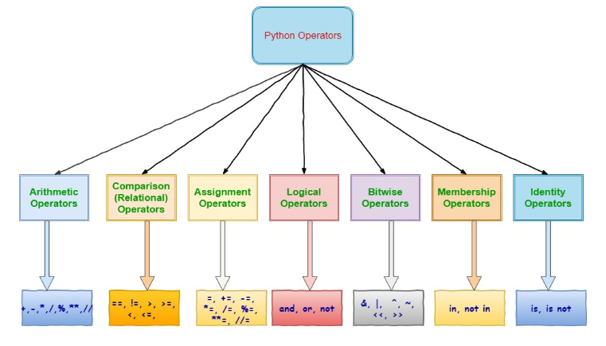
OPERATORS

Slide 24
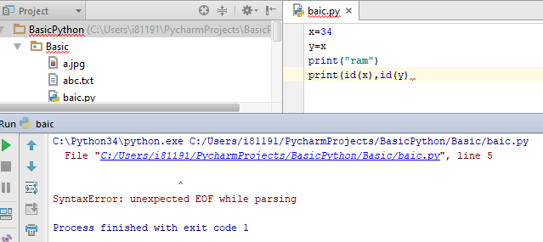
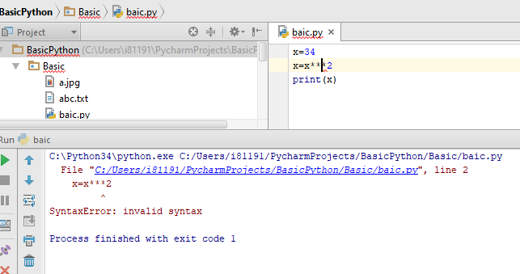
Error-Syntax error
Also known as compile time error
Mistakes that are against the rules of the language
Example: In Python, every closing parenthesis should be matched with a preceding opening parenthesis. So the next command has a syntax error. (75-12)/4)
Easy to find out: IDEs highlight the mistakes when you write code
You receive an error message when you try to run
For an interpreted language (like Python) the code is not executed if syntactically incorrect

Slide 25
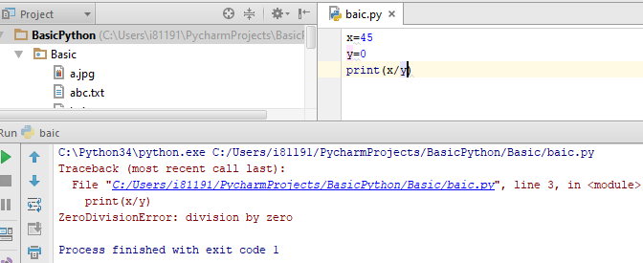
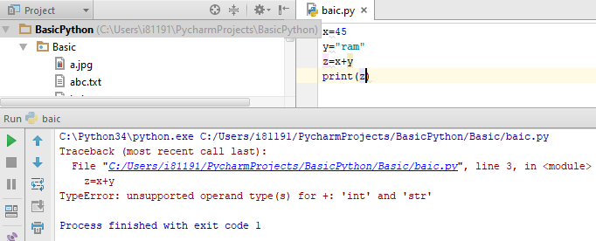
Error-runtime error
Also known as compile time error
Code is syntactically correct, however, results in the performance of illegal operation.
Example: In Python, dividing by zero is illegal. Hence the next command is syntactically correct, but causes a runtime error >>> (75-12)/(4-2*2)
Example: In Python, we cannot add objects of different types. >>> Birthday = 29 + "February " + 1991
Will be identified, but not until code is running. With large code this could result in long delay Runtime errors are called exceptions: because they usually mean something exceptional has happened

Slide 26
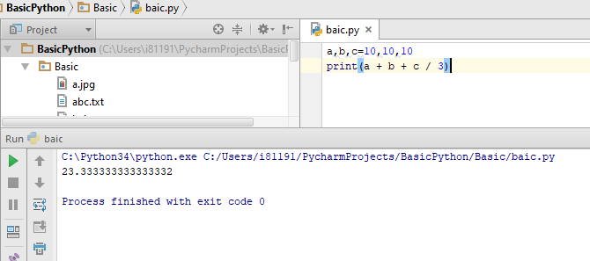
Error-logical error
This is when code is syntactically correct, and runs without errors, but is still incorrect.
Example: The following code aimed to find the average of 3 numerical values stored in the variables a,b,c. >>> a + b + c / 3 It fails because we forgot the brackets
Example: We saw earlier that the following code causes no error. >>> Birthday = str(29) + "February " + str(1991) However, 1991 was not a leap year so it cannot be correct
These are the most difficult errors to uncover as No error messages provided . Caused by computers doing what you told them to do instead of what you wanted them to do

Slide 27
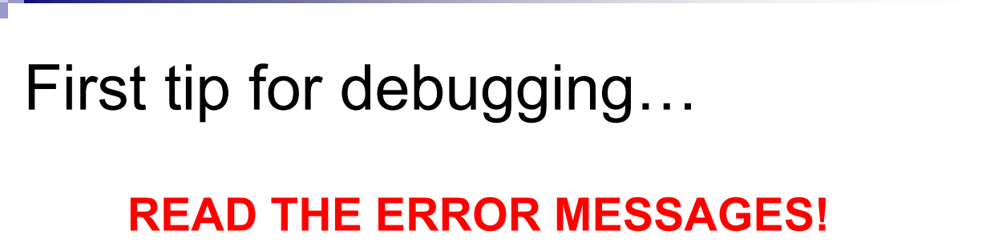
Debugging
Programming errors are commonly called bugs. Finding & correcting them is called debugging Bugs are common place in programming.
You cannot avoid them, you must deal with them
Debugging is one of the most important skills for a programmer.
Some even argue it is the most interesting / challenging part of programming
IT IS A KIND OF DETECTIVE WORK, YOU HAVE SOME/NO CLUE, AND YOU HAVE TO FIND THAT

Slide 28
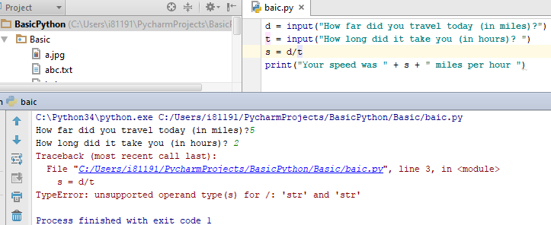
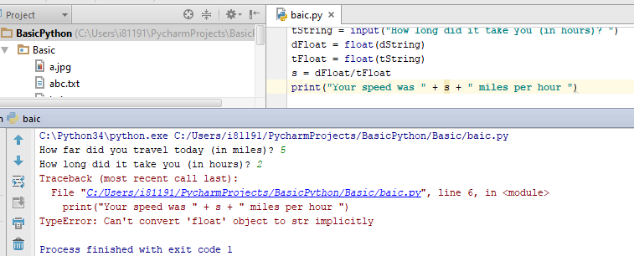
dEBUGGING

Slide 29
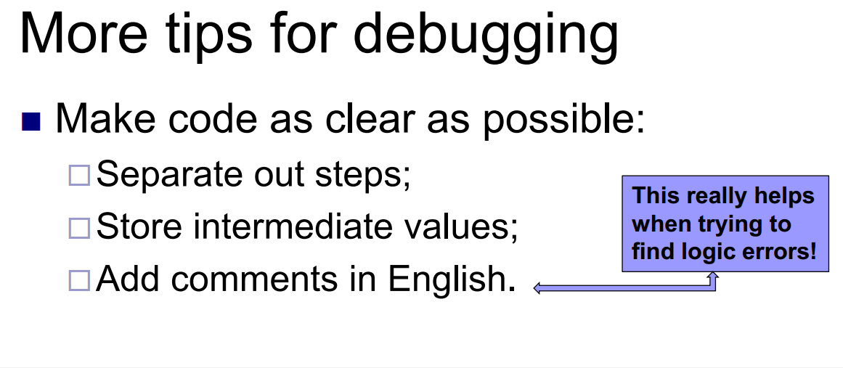
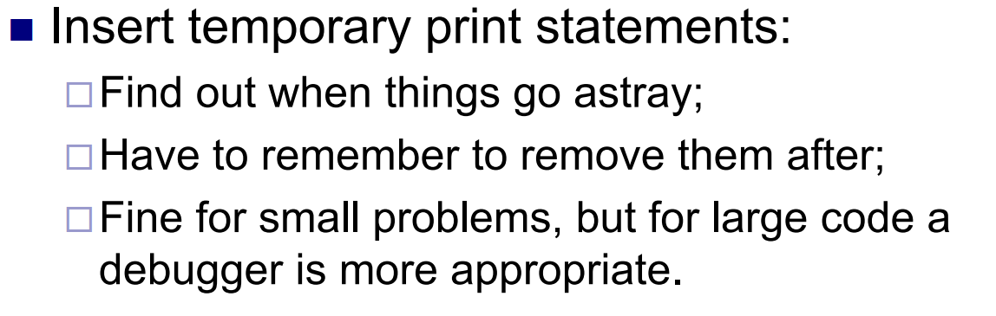
debugging
F8

